Slide 1

Resturant System

Slide 2
Project Team
. طه مصطفى عباس عقيلى
. سانتي اسامة مينا حنا
. شادي عبد الفتاح محمد ثابت
. عبد الله احمد عبد الله دياب
. سيف الدين عصام حسن محمود

Slide 3

Description
We have made this program in order to be able to manage a restaurant and control all its data by making a lot of tables for all the components of the restaurant, including managers, employees, customers or halls.

Slide 4

For Example
The owner of the restaurant wants to know the consumption of customers of a particular commodity in order to improve its quality
Or he wants to evaluate the performance of one of the managers and how many customers there are during his work period
Or he wants to add one of the goods or remove one of the goods from the menu
Or delete the name of one of the employees or add the name of a new employee or a new product

Slide 5

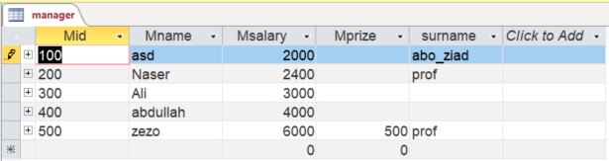
We have taken many steps to implement this project, the first of which is the tables :
Manager table:
The names of the directors and their number to identify me and their titles

Slide 6

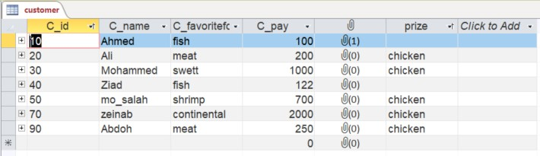
We have taken many steps to implement this project, the first of which is the tables :
Customer table:
It contains the names of customers, their identification numbers, favorite meals, and the number of times a particular food is administered

Slide 7

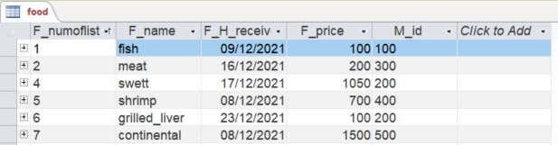
We have taken many steps to implement this project, the first of which is the tables :
Food table:
The names of the directors and their number to identify me and their titles

Slide 8

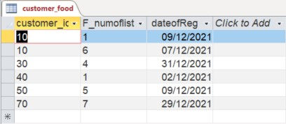
We have taken many steps to implement this project, the first of which is the tables :
Customer Food :
A table containing the urdurate of each of the customers and it has a primery key, which is the food-special Premier Key and the customer's premier key.

Slide 9
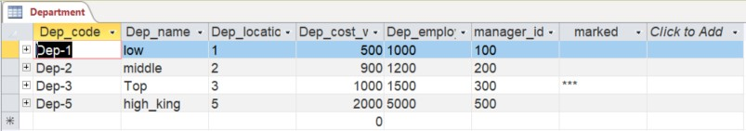
We have taken many steps to implement this project, the first of which is the tables :
Department table :
Table contains sections in the restaurant and contains Primry Key that is id for the section

Slide 10
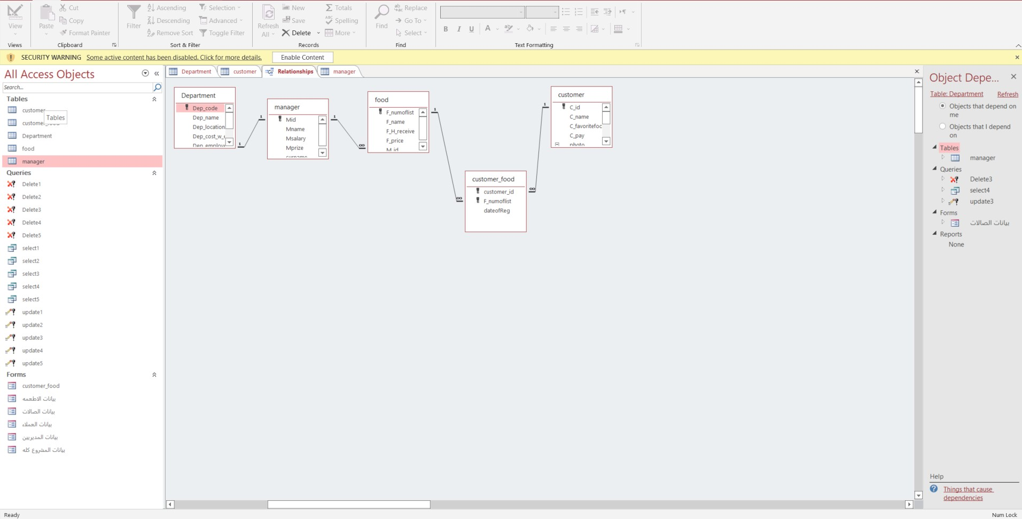
Then we linked these tables together with specific relationships as follows: :

Slide 11

Then we make a set of inquiries so that we can get the data that we have entered Like ::
query delete Deletes all data of the object to be deleted
query select Selects the specific data we want to search for
query select associated form and report The user enters the data to be searched for
query select associated form and report The user enters the data to be searched for
query update We put the condition to be modified and write the thing to be modified
query update associated with the user form is the one who enters the data

Slide 12
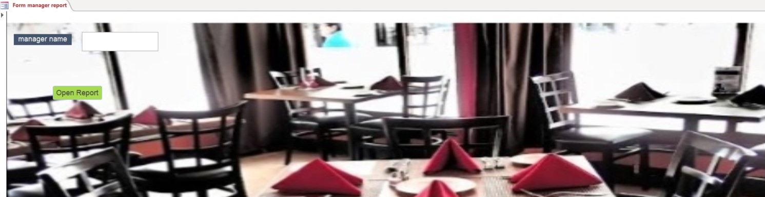
There are four types of form
form wizard :
that works on one table

Slide 13
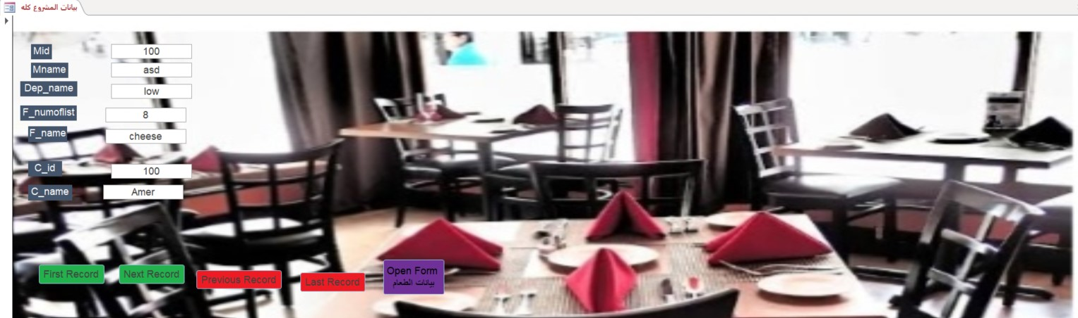
form design :
works on more than one table

Slide 14
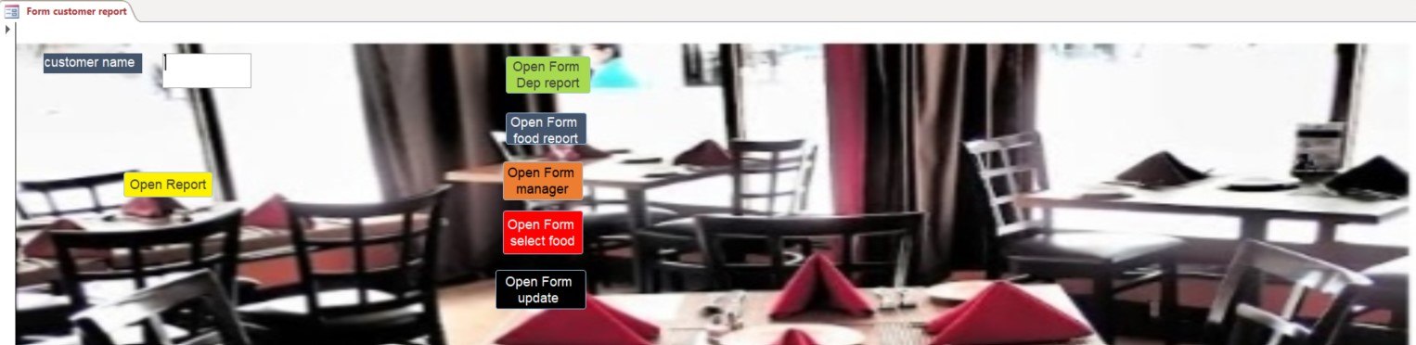
the associated form query and report the user enters the data into the form and we print it in the form of a report:

Slide 15
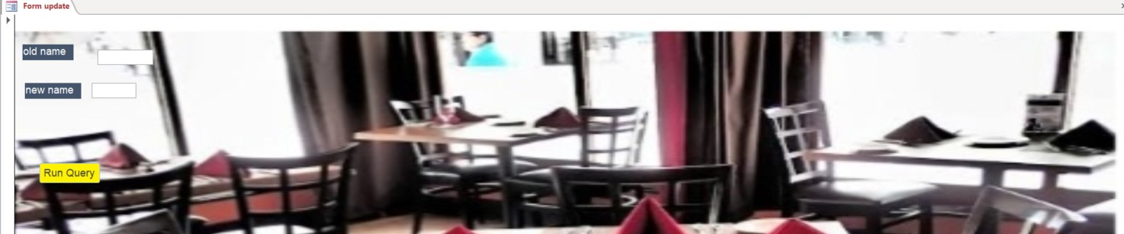
form associated with the query user enters what he wants to do in query

Slide 16
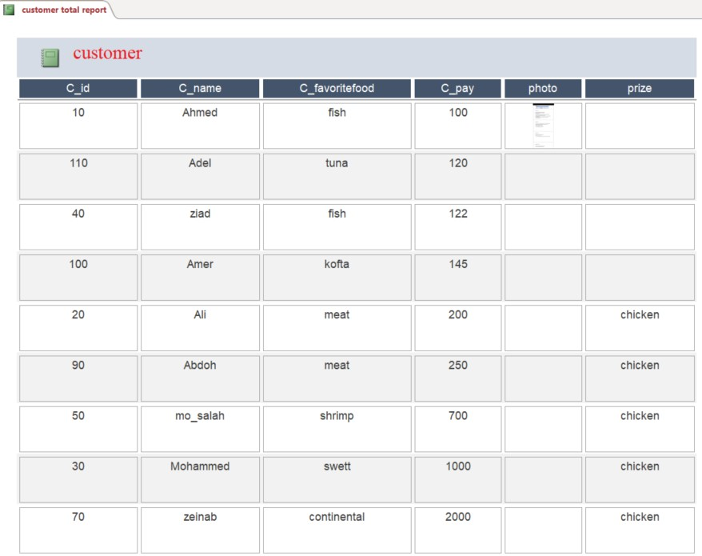
There are two types of Report :
Report, which prints everything related to one table, by selecting the table to be printed in the form of a report, and we click on Report

Slide 17
THANK YOU

